Slide 1
Self-supervised learning
3조
Geon Min, Seong Hun Jeong
Masked Auto encoder(MAE)

Slide 2
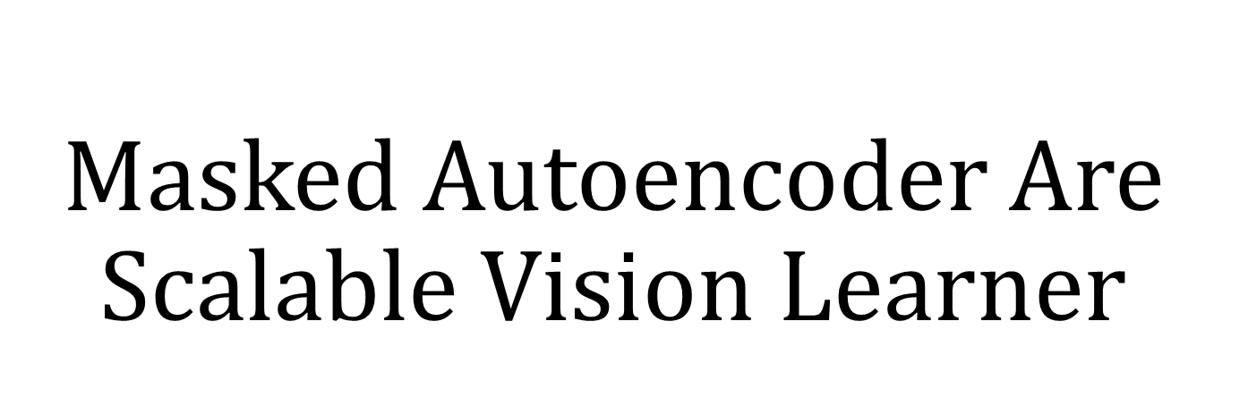
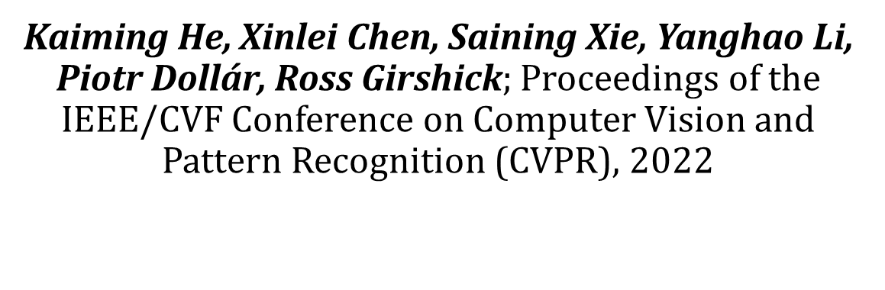

Slide 3
Introduce
Deep learning has witnessed an explosion of architectures of continuously growing capability and capacity.
Aided by the rapid gains in hardware, models today can easily overfit one million images and begin to demand hundreds of millions of labeled images.
This appetite for data has been successfully addressed in natural language processing(NLP) by self-supervised pre-training.

Slide 4
Problem Statement
What makes masked autoencoding different between vision and language?

Slide 5
Problem Statement
Architecture gap
Unlike NLP, it is difficult to use mask token or positional embedding in Vision because CNN were dominant for last decade, which is typically operate on regular grids and it is not straightforward to integrate ‘indicators’ such as mask tokens or positional embeddings into convolutional networks.
Information density
As human generated signal, languages imply high semantic and information dense. In contrast, images are natural signal with heavy spatial redundancy. This can be solved by masking very high portion.
Decoder’ s roles
In vision, decoder reconstructs pixel, its output is of a low semantic level. In NLP, decoder predicts missing words, its output is of a rich semantic levels, therefore, decoder design plays a key roles in determining the semantic level of the learned latent representations.

Slide 6
Proposed method
A mask is applied at a high ratio (75% or more) to eliminate spatial redundancy between patches.
Through the encoder-decoder structure of the asymmetric structure, the computational efficiency is increased, and the scale is greatly increased.

Slide 7
Related works
masked language modeling
ex) BERT, GPT
Auto-encoder
ex) DAE(Denoising autoencoder)
masked image encoding
from convolutional networks to Transformer, ex) BEiT(BERT pre-training of image Transformers)
self-supervised learning
contrastive learning

Slide 8
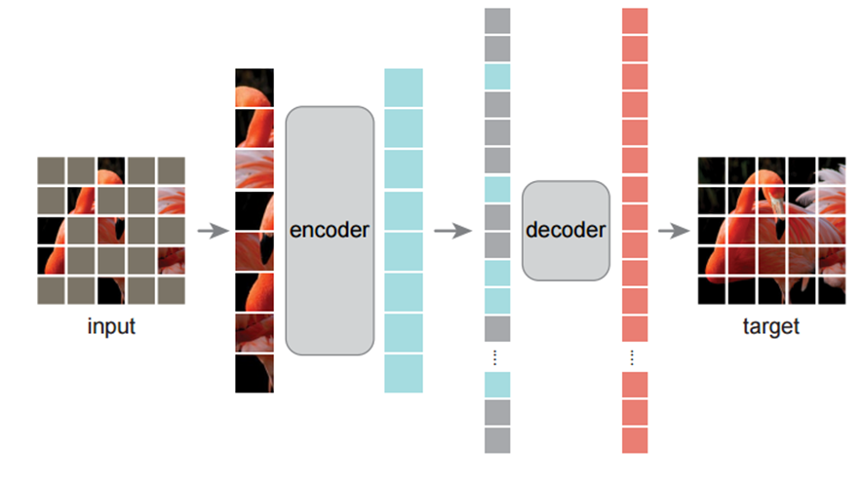
MAE
Asymmetric auto-encoder architecture
Encoder
masking input. (binary mask)
encoding only visible ones.
Light weight decoder
concatenate visible and masked.
decoding for reconstruction target.

Slide 9
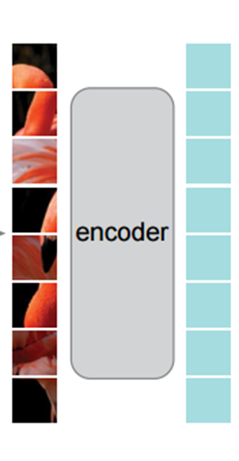
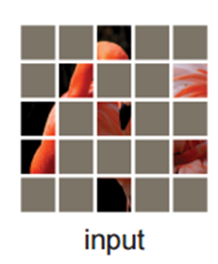
Encoder
Follows ViT(input images are divided to ‘n x n’ patches with same size)
Samples random patches according to a uniform distribution.
Same as ViT, only difference is inputs which are only unmasked patches.
Notes:
With high masking ratio(default : 75%), sampling largely eliminates redundancy
Uniform distribution prevents a potential bias

Slide 10
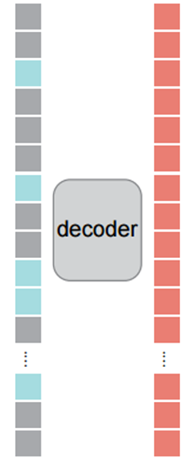
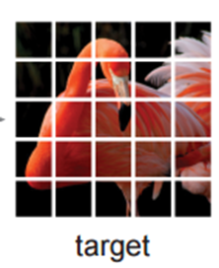
Decoder
Input is the full set(encoded visible tokens + mask tokens) which has positional embedding.
Decoder architecture can be flexibly designed regardless of encoder.
Only on masked patches.
Using normalized patches increases representation’ s quality.

Slide 11
Experiments setting
self-supervised pre-training on the ImageNet-1K training set
supervised training to evaluate the representations with
end-to-end fine-tuning
linear probing
Baseline
ViT-Large(ViT-L/16), bigger than ResNet-50
fine tuning epoch
50 epoch for MAE SSL
200 for scratch

Slide 12
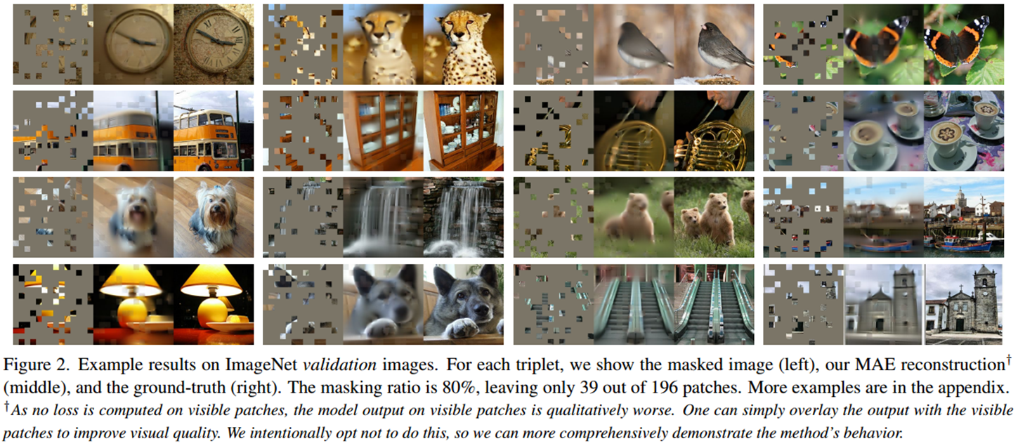
Experiments result

Slide 13
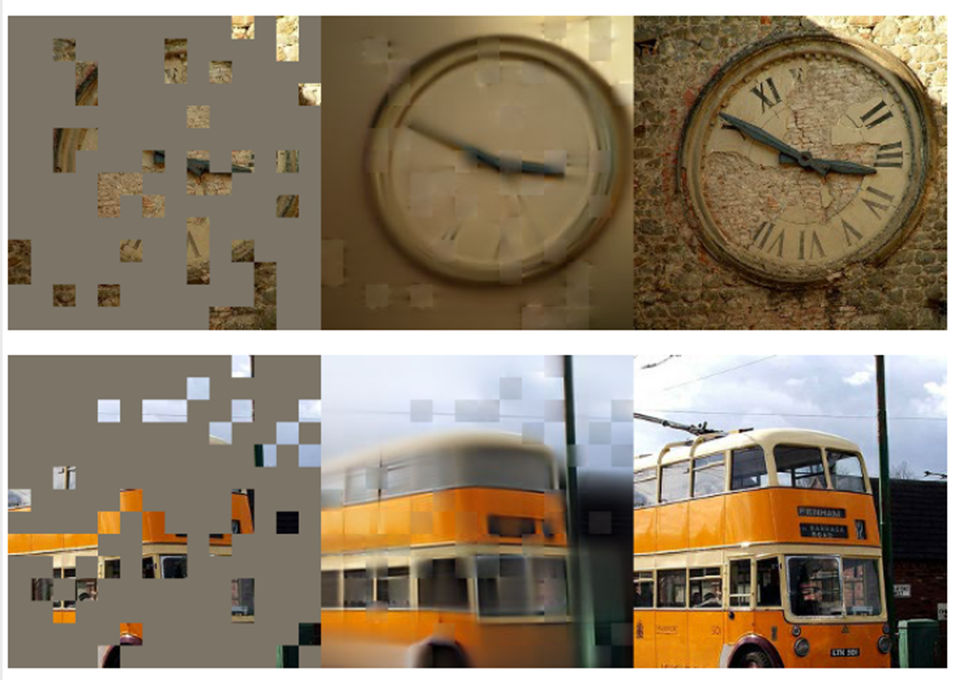
Experiments result
Results of reconstructing only masked patches.
it can be seen that the image structure of the invisible patch was reconstructed using only the visible patch data.

Slide 14
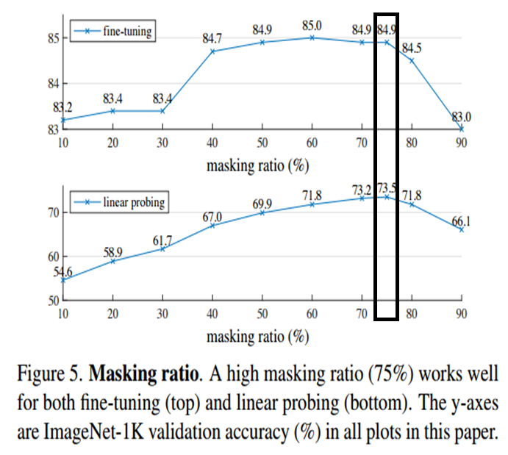
Ablation
Both highest with masking ratio 75%.
The accuracy gap between linear probing and fine tuning is significant, and fine-tuning is higher than the performance of the ViT scratch in any masking ratio (82.5%).

Slide 15
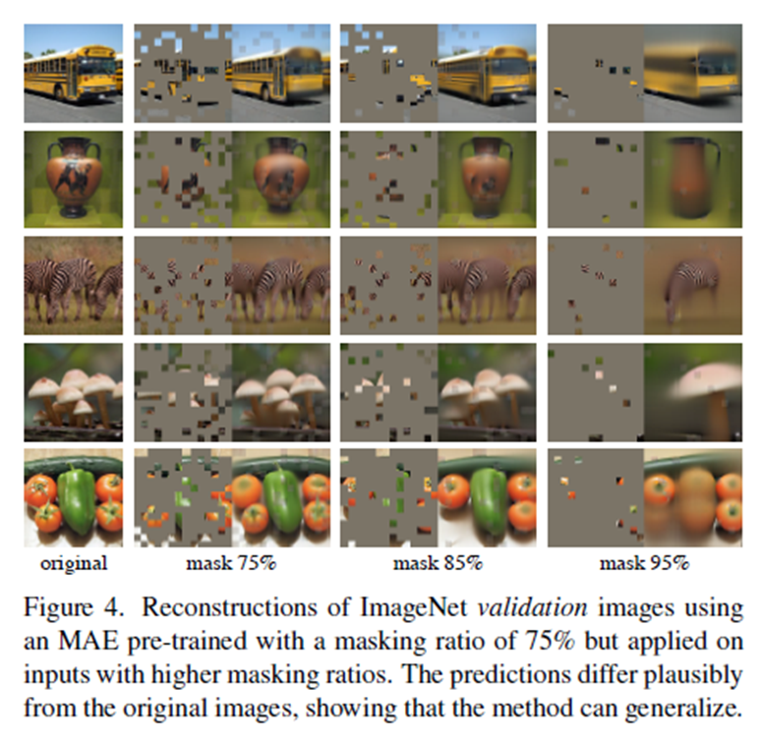
Cont’

Slide 16
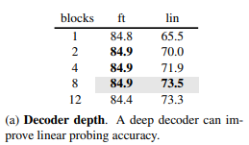
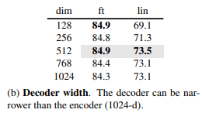
Cont’
In linear probing metric, deep decoder is important. But fine-tuning, the decoder depth is less influential
A narrow decoder performs well on default width.
Overall, our default MAE decoder is lightweight(8 block, 512-dim).
Only has 9% FLOPs per token vs. ViT-L (24 blocks, 1024-d).
Notes:
decoder depth랑 width는

Slide 17
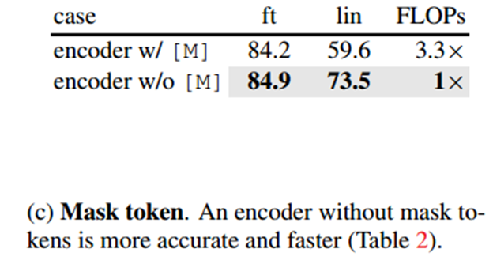
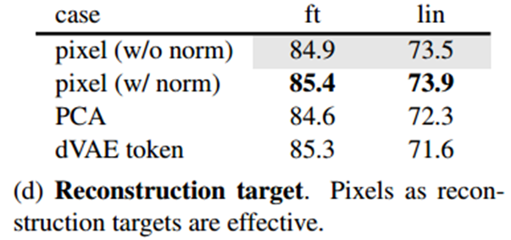
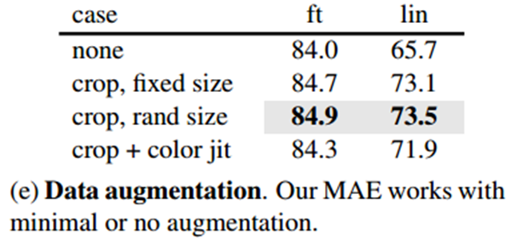
Cont’
The results are better when only the visible patch is input to the encoding.
pixel as reconstruction targets are effective.
MAE is less affected by data augmentation.

Slide 18
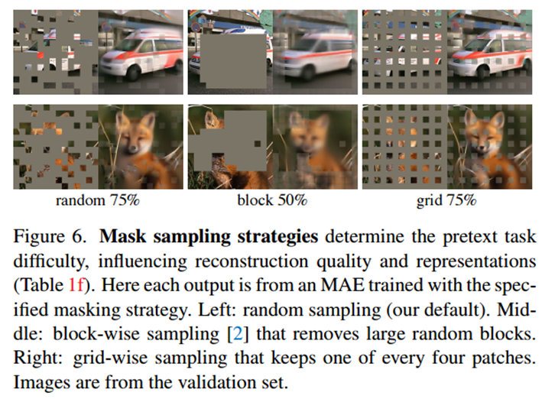
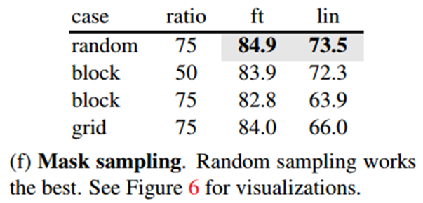
Cont’
Random sampling works the best in mask sampling strategies.

Slide 19
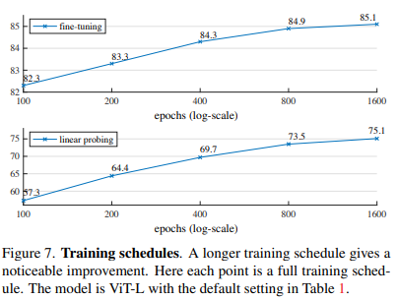
Cont’
The accuracy improves steadily with longer training.
Did not observe saturation of linear probing accuracy even at 1600 epochs.
This behaviour is unlike contrastive learning.

Slide 20
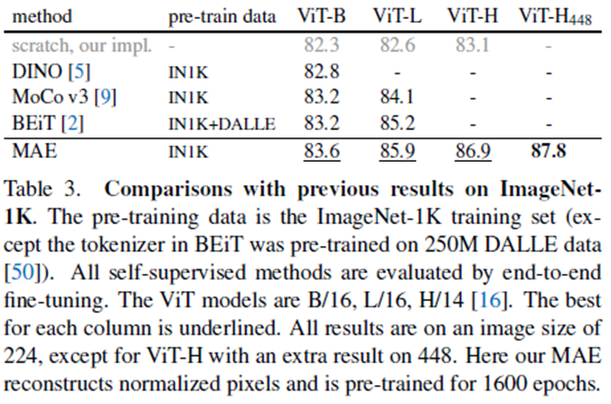
Comparisons with previous methods
Comparisons with previous self-supervised learning methods.
Except BEiT, all methods were pre-trained with IN1K.
MAE result is based on vanilla ViT, so can expect advanced network will perform better.

Slide 21
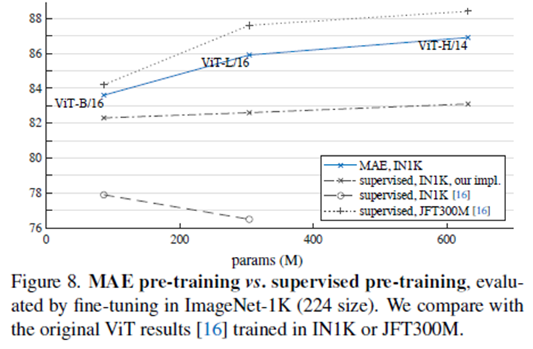
Comparisons with previous methods
Original ViT-L degrades on IN1K.
Scratch from the paper performs better, but accuracy was saturated.
MAEs gain over training from scratch is bigger for higher-capacity models.
MAE follows a trend similar to the JFT-300M. So, MAE can help scale up model size.

Slide 22
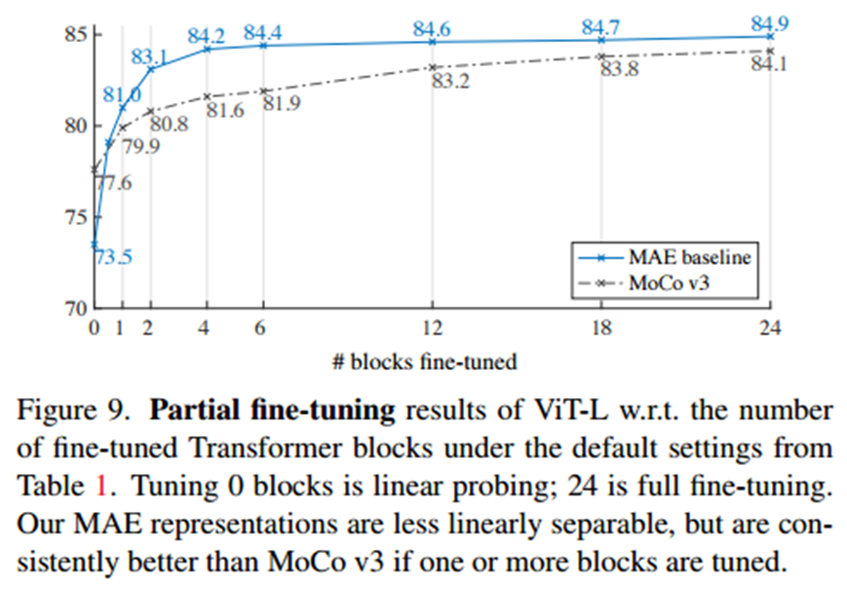
Cont’
Even if fine-tunes only half block (i.e., MLP sub-block), can get 79.1%, much better than linear probing.
Fine-tuning a few blocks (e.g., 4 or 6) can achieve accuracy close to full fine-tuning.
Compare with MoCo v3 with ViT-L. All of its partial fine-tuning results are worse than MAE.
While the MAE representations are less linearly separable, they are stronger non-linear features and perform well when a non-linear head is tuned.

Slide 23
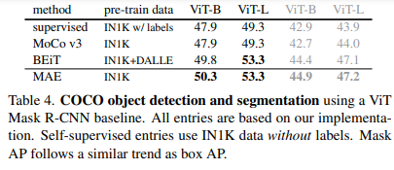
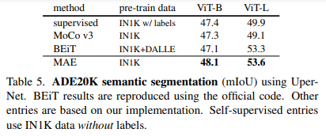
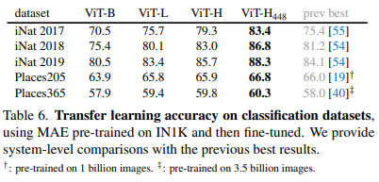
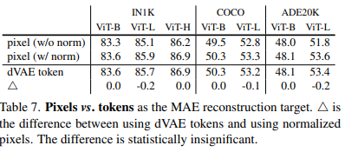
Transfer learning on other tasks

Slide 24
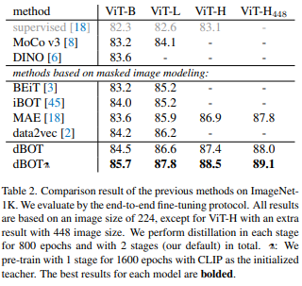
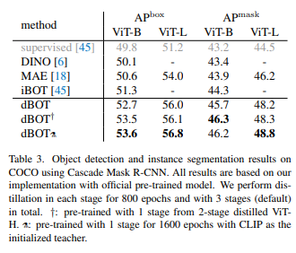
Our problem statement
The result of reconstruction about the masked token is too blurry. Therefore MAE’ s representation learning is still lacking
REF : Exploring Target Representations for Masked Autoencoders, https://arxiv.org/pdf/2209.03917v2.pdf
Notes:
출처 : 논문 https://arxiv.org/pdf/2209.03917v2.pdf
다른 논문 들과도 비교한 자료 : https://paperswithcode.com/sota/self-supervised-image-classification-on-1

Slide 25
Our solution
Therefore, MAE requires more fine training about reconstruction.
By adding other loss function.
ex) perceptual loss like LPIPS.
*LPIPS : Learned Perceptual Image Patch Similarity
Should be penalized for unbiasing model .
Adding sub-networks like knowledge distillation or else.

